Slide 1
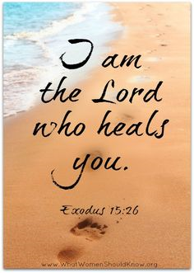
How God Heals the Brain
TIMOTHY B. WALSH, M.A., L.P.; DPA
Minnesota Adult and Teen Challenge
VICE PRESIDENT OF LONG TERM RECOVERY & MENTAL HEALTH SERVICES

Slide 2
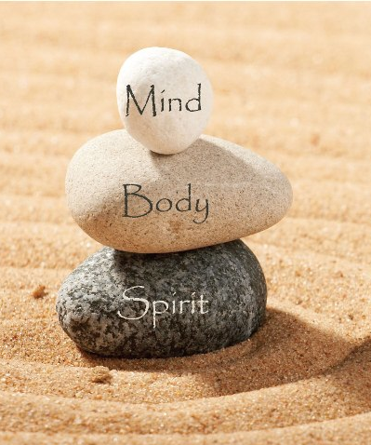
θεραπεύω
To heal, cure, make whole

Slide 3
THE CHRISTIAN WAY OF LIFE changes the chemistry in your brain and body
Daily & Practiced Meditation + Deep and Continuous Prayer + Compassionate Service + Fellowship + Giving/Tithing + Worship + Confession + Thanksgiving + Forgiving + Praise + Solitude + Humility Disciplines + Soul Friendships + Bible reading + Sabbath + Work/Exercise + Fasting (Diet Health)
+ Re-creation…..= TRANSFORMATION

Slide 4
Faith & Spiritual Practice
More Effective 80% of the Time!
NIH Psychiatrist, David B. Larson in God: The Evidence
Decreases Alcohol Abuse
Decreases Depression, Anxiety and Stress
Decreases Divorce
Increases Marital and Sexual Satisfaction
Increases Overall Happiness and Psychological Well Being & Longevity
Studies cited on pages 183ff in Glynn, P. (1997). God The Evidence: The Reconciliation of Faith and Reason in a Postsecular World. Also, Newberg (2009) p.28, 140

Slide 5
“The Christian ideal has not been tried and found wanting; it has been found difficult and left untried” – G. K. Chesterton

Slide 6
The Transformation of the Mind
(Prov.23:7) As a man thinks within himself/so he is
(Col 3:1) Therefore if you have been raised up with Christ, keep seeking the things above, where Christ is, seated at the right hand of God.
(Col 3:2) Set your mind on the things above, not on the things that are on earth.
(Rom 8:5) For those who …are according to the Spirit (set their minds on) the things of the Spirit.
(Rom 8:6-8) “…the mind set on the Spirit is life and peace”
(Rom 12:2) And do not be conformed to this world, but be transformed by the renewing of your mind…”
(Heb 12:2) Fix our eyes on Jesus, the author and perfecter of our faith
(2 Cor.3:18) And we all, who with unveiled faces contemplate the Lord’s glory, are being transformed into his image with ever-increasing glory, which comes from the Lord, who is the Spirit.

Slide 7
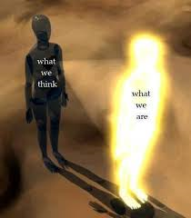
Let this mind be in you which was also in Christ Jesus (Phil 2:5)
What is my “MIND?” Not Just the Brain…heart, spirit, innerperson…
noús – the God-given capacity of each person to think, to reason; the mental capacity to exercise reflective thinking. For the believer, (noús) is the organ of receiving God's thoughts, through faith. Source: Strong’s Concordance

Slide 8
The MIND is MUCH greater than the Brain
Lipton, B. (2008). The Biology of Belief: Unleashing the Power of Consciousness, Matter and Miracles
We are made up of 50 trillion cells…
Each cell is like a person; it is “intelligent” and communicates collectively with the “mind” of other cells as a “Community” to respond to the outside world
What we believe (and perceive) affects the health and life of our cells as we respond to our world
Our genetics DO NOT determine our destiny!

Slide 9

Our Brain IS Designed for Spirituality!
V.S. Ramachandrian (20ll). The Tell Tale Brain

Slide 10
Are we able to “transform” the mind?
The Brain seems to think so ☺
“…the human brain seems to have difficulty separating fantasies from facts. It sees things that are not there, and it sometimes doesn’t see things that are there. In fact, the brain doesn’t even try to create a fully detailed map of the external world. Instead, it selects a handful of cues, then fills in the rest with conjecture, fantasy,
and belief”
Source: Newberg, A.; Waldman M. (2009). How God Changes Your Brain: Breakthrough Findings from a Leading Neuroscientist. New York: Ballantine Books

Slide 11
Why HEALING of the MIND often has to be wide, deep, and long
E.g. Trauma
Shock
Abuse
Neglect
Abandonment
Rejection
Grief
Loss
Habitual Sin; Addictions
False images of God
What processes information 1 million times
faster? Source: Lipton (2005) The Biology of Belief

Slide 12
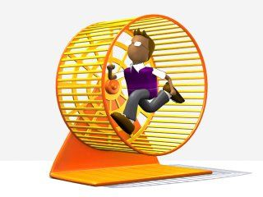
Recurrence/”Looping”
aka
Re-membering
Re-collection
Re-hearsing
Ruminating
Re-living
Re-experiencing
The Gerbil on the Wheel
How we cause
our own
suffering…

Slide 13

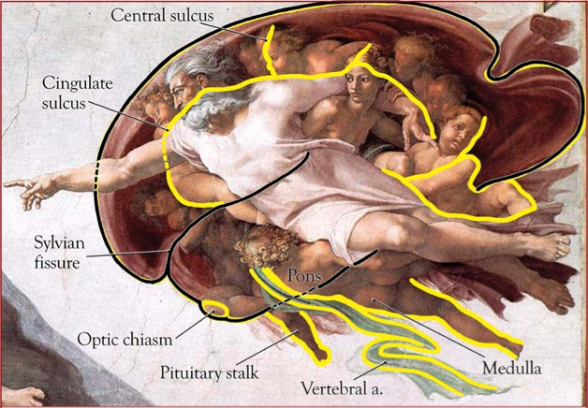
Source: Newberg, A.; Waldman M. (2009). How God Changes Your Brain: Breakthrough Findings from a Leading Neuroscientist. New York: Ballantine Books.

Slide 14
1. Each part of the brain constructs a different perception of God.
2. Every human brain assembles its perceptions of God in uniquely different ways, thus giving God different qualities of meaning and value.
3. Spiritual practices, even when stripped of religious beliefs, enhance the neural functioning of the brain in ways that improve physical and emotional health.
4. Intense, long-term contemplation of God and other spiritual values appears to permanently change the structure of those parts of the brain that control our moods, give rise to our conscious notions of self, and shape our sensory perceptions of the world.
5. Contemplative practices strengthen a specific neurological circuit that generates peacefulness, social awareness, and compassion for others. (ibid, p.6-7)

Slide 15
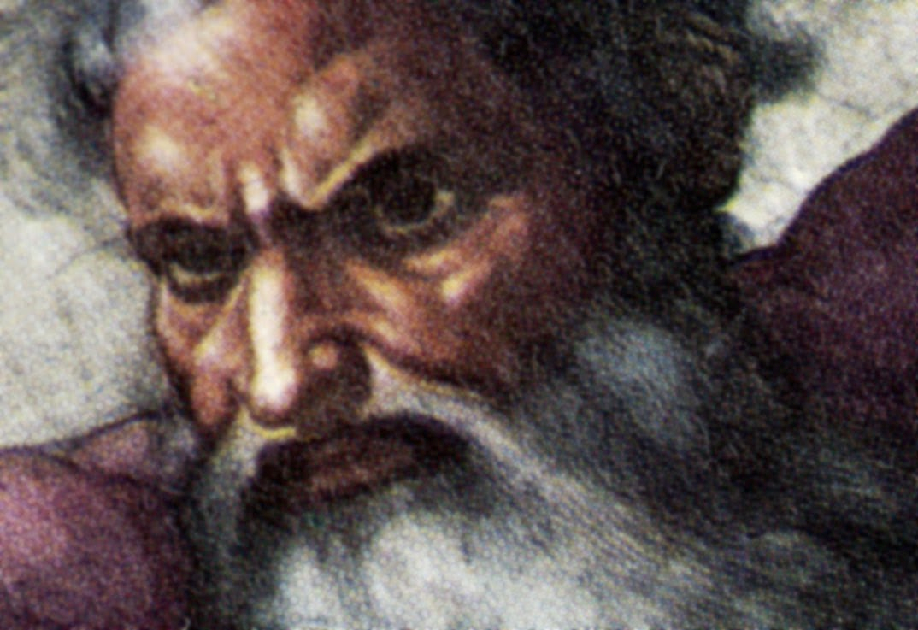
Images of “god” that negatively affect physical and mental health
Oppressive tyrannical fear-based HOSTILE raging power monger Punishing INTOLERANT SEPARATIST dominating coercive SHAMing REJECTING = god HATES ME …
Jennings, T. (2013). The God-Shaped Brain. IVP Books.

Slide 16
The “Inflammatory cascade”
“Worshiping an authoritarian, punishing god inflames the fear center (amygdala), damages the prefrontal cortex and impairs healing and growth…increases in fear, guilt and shame” (p127; 130)… Increases stress hormones, blood pressure, heart rate, brain damage, early death (p.42)
Jennings, T. (2013). The God-Shaped Brain. IVP Books.

Slide 17
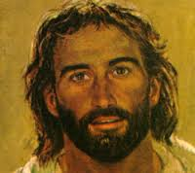
A “JESUS-LOOKING” GOD:
Yeshua ישו: To SAVE, TO DELIVER, TO HEAL

Slide 18
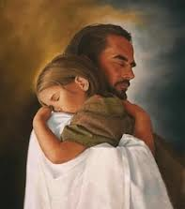
Come to Me, all who are weary and heavy-laden, and I will give you rest. Take My yoke upon you and learn from Me, for I am gentle and humble in heart, and YOU WILL FIND REST FOR YOUR SOULS--Jesus

Slide 19

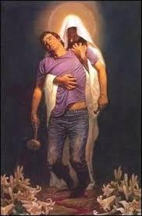
FEELING FOR &
CARING FOR OTHERS
FAITH IN A LOVING GOD
“Not only does other-centered love increase when we worship a God of love, but sharp thinking and memory improve as well. In other words, worshiping a God of love actually stimulates the brain to heal and grow”
Jennings, 2013, p.27

Slide 20
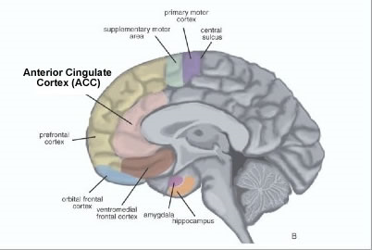
ANTERIOR CINGULATE
“Allows you to experience God as loving and compassionate. It decreases religious anxiety, guilt, fear, and anger by suppressing activity in the amygdala”
Newberg, 2010

Slide 21
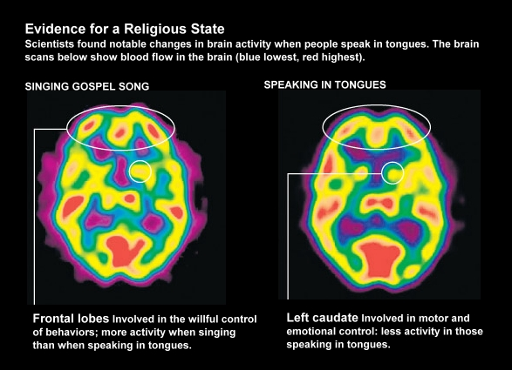
http://www.pewforum.org/2008/05/05/how-our-brains-are-wired-for-belief/
Ecstatic Experiences

Slide 22
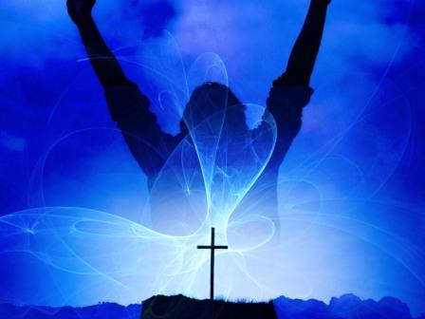
The Healing Power of Praise and Worship
1 Samuel 10:6
⁶ The Spirit of the Lord will come powerfully upon you…and you will be changed into a different person.

Slide 23
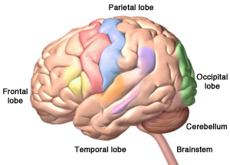
Parietal-Frontal Circuit: “If you decrease activity in your parietal lobe through meditation or intense prayer, the boundaries between you and God dissolve. You feel a sense of unity with the object of contemplation and your beliefs” p.43
Newberg, 2010

Slide 24
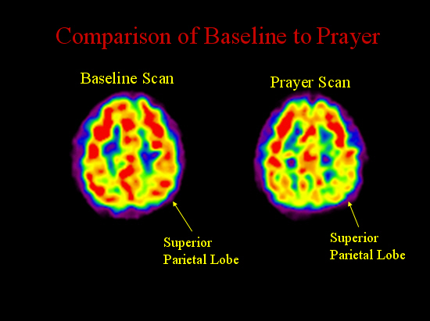
Single Photon Emission Computed Tomography: SPECT (blood flow in the brain)
PRAYER: Daily, Deep, Sustained

Slide 25
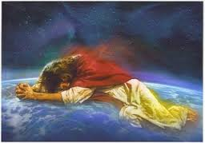
THE HEALING POWER OF MEDITATION
Thy Kingdom Come
Thy Will
Be Done
AS IT IS IN HEAVEN
ON EARTH
Siegel, R.D. (2010). the mindfulness solution: Everyday Practices for Everyday Problems. New York: The Guilford Press.

Slide 26
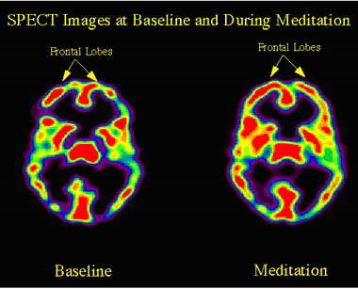
THE HEALING POWER OF MEDITATION
Thy Kingdom Come
RX= 40 Minutes per day over a period of years (Newberg, M.D.)
Thy Will
Be Done
AS IT IS IN HEAVEN
Contentedness, satisfaction, “happy natural chemicals”, and less negative moods and hypervigilance
ON EARTH
Davidson, R.J., Kabat-Zin, J., Schumacher, J., Rosenkranz, M., Muller, D., Santorelli, S., et.al. (2003). Alterations in brain and immune function produced by mindfulness meditation. Psychosomatic Medicine, 65(4) 564-570.
Lazar, S., et. al, NeuroReport, 16(17), 1893-1897. Ibid. Newberg

Slide 27
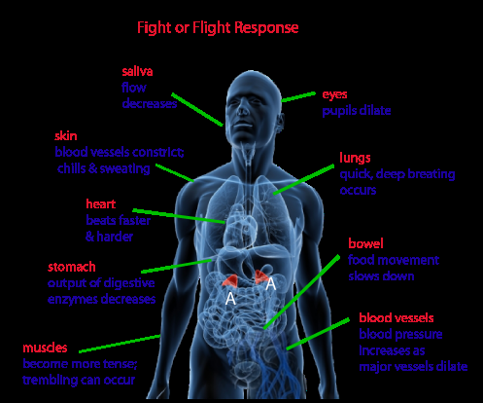
“Perfect Love casts out” Primal Fear and Aggression (Jennings, 2013; 1 Jn 4:18)
Lowers the stress-out chemicals in the brain
epinephrenine and norepinephrine (Newberg, p.56)

Slide 28
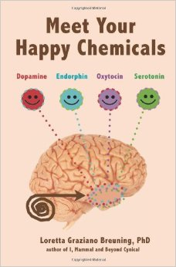
Overcoming Addiction & other lesser gods
Feeling…..
Bonded
Connected
Loved

Slide 29
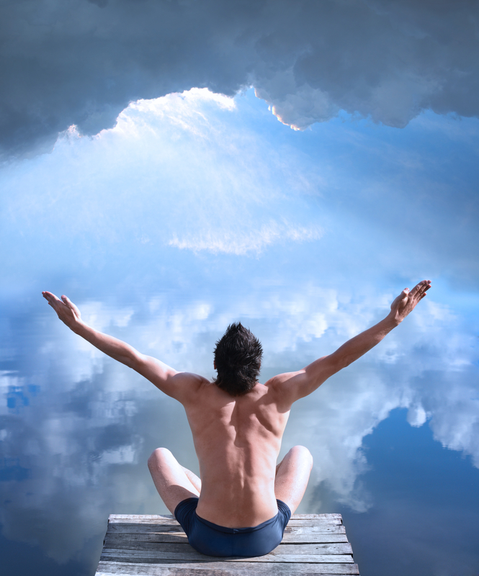
HOPE = “Optimism Bias”
Decreased stress=
Reduced risk for coronary disease=
Improved coping skills=
Better memory=
Reduced cortisol levels=
You live longer and healthier
Source: Mayo Clinic, et. al. in Newberg

Slide 30
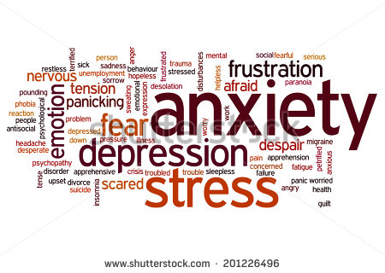
Melt the clouds of sin and sadness
Drive the dark of doubt away
Emmons, H., M.D. (2006). The Chemistry of Joy. New York: Fireside
Ibid (2010). the chemistry of calm. New York: Touchstone.

Slide 31
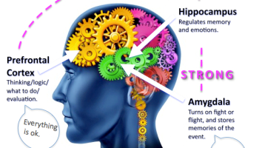
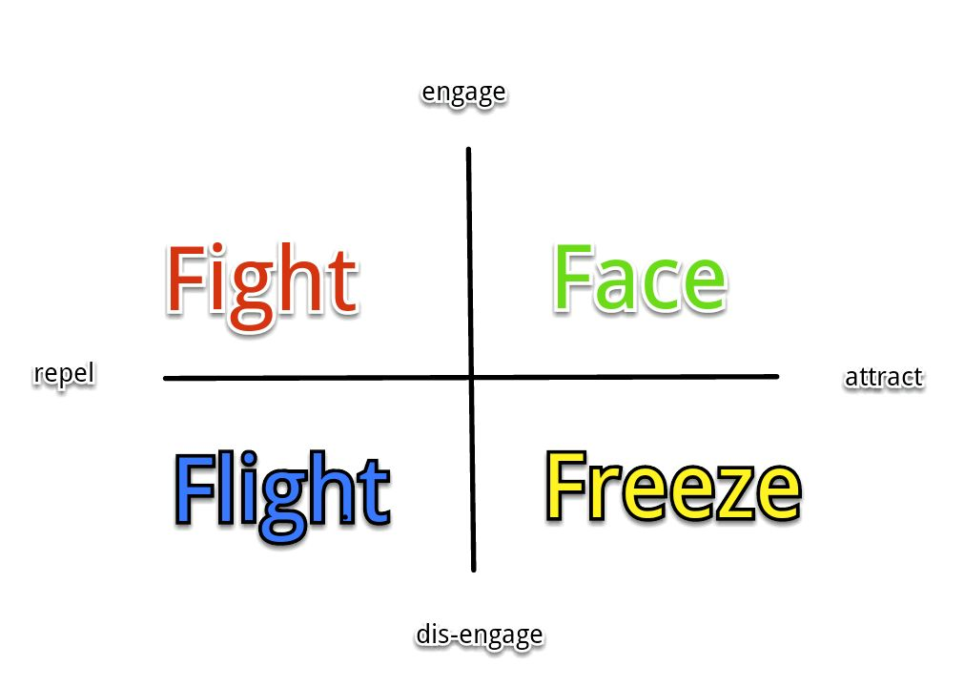
Changes the “Circuits”
In your brain so you don’t do the 3 F’s (Emmons, 2010, 2006)

Slide 32
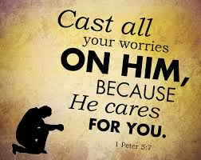

Slide 33
HOLDING ON (Attachment) | LETTING GO (Aversion)
The Good Times Pleasant Experiences Faith Spiritual Identity NOT Hold onto: Unforgiveness Grudges Bitterness Resentments Loss Grief Disappointment | The Bad Times Unpleasant Experiences Trauma, Shock…. Negative Thoughts Negative Emotions Negative Sensations Negative Images
Helps you to hang on to the good stuff and let go of the bad stuff

Slide 34
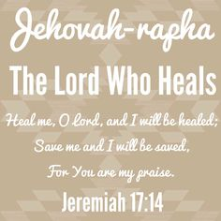
Healing Meditation: God is the God who heals

Slide 35
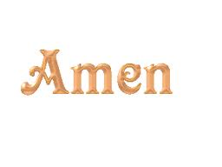
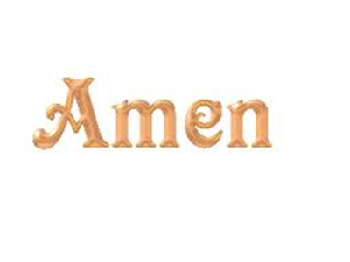
I agree
with God
I affirm it
as true
I accept he has done I accept he will do
what he has said what he has said
he has done he will do
Let it be
So be it
Make it so

